Slide 1
FCC3 246: CONCRETE MATERIALS
Lecture 8: KEY PROCESSES OF CONCRETE PRODUCTION AND APPLICATION
Department of Civil & Construction Engineering
University of Nairobi
mwauras@uonbi.ac.ke

Slide 2
Key Processes in the Manufacture and Application of Concrete
Batching
Mixing
Transportation
Placing
Compaction
Curing

Slide 3
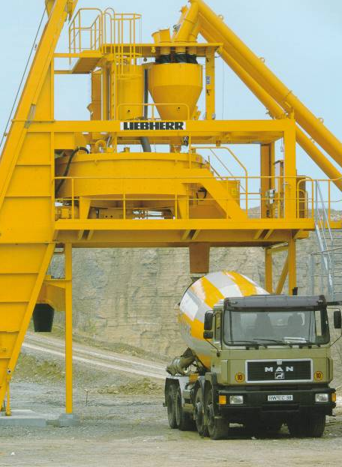
Plant for Batching & Mixing.
Truck for Transportation

Slide 4
Batching

Slide 5
Batching
Proportioning the key ingredients of concrete whose proportions determine the final hardened concrete strength for a given water-cement ratio. It is more accurate to batch by weight than by volume
Large construction sites have Batching Plants where the different ingredients are weighed in suitable proportions before mixing to make concrete
For a given water-cement ratio, and assuming no use of admixtures, the strength of hardened concrete is determined from the ratios of the proportions of the ingredients and the process of determining these ratios or the method of mixing selection is referred to as Mix Design
We normally refer to the class of concrete which is the Compressive Strength of concrete in N/MM². For example, class 20 is compressive strength of concrete that is equivalent to 20N/MM²
Concrete class is hardened concrete compressive strength in N/MM².

Slide 6
Batching
Concrete Class N/MM² | Ratio | Cement | Fine Aggregate | Coarse Aggregate
20 | 1:2:4 | 1 | 2 | 4
25 | 1:1.5:3 | 1 | 1.5 | 3
30 | 1:1.5:2 | 1 | 1.5 | 2
35 | 1:1:2 | 1 | 1 | 2

Slide 7
Batching Plants
Small plants loaded by hand using shovels
Larger plants use mechanical loading such as hand scrapers, booms, bucket draglines or front end loaders for loading hoppers
Aggregates are weighed using load cells or lever arms
Water is measured by flow meter
Bulk cement weighed by load cells
If bagged cement is used, other materials are proportioned to weight of cement bag.

Slide 8
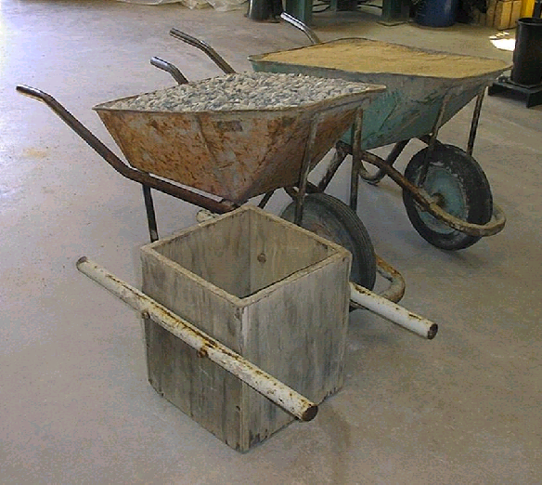
Mix Proportions by Volume
Proportioning is given in volume or ratios
Done with buckets, gauge boxes or wheelbarrows
Usually given in short-hand form as follows
  1:2:4 or 1:1:2 etc
Recommended for small jobs
Conservative
Unknown strength
Varies with materials
Bulking of sand

Slide 9
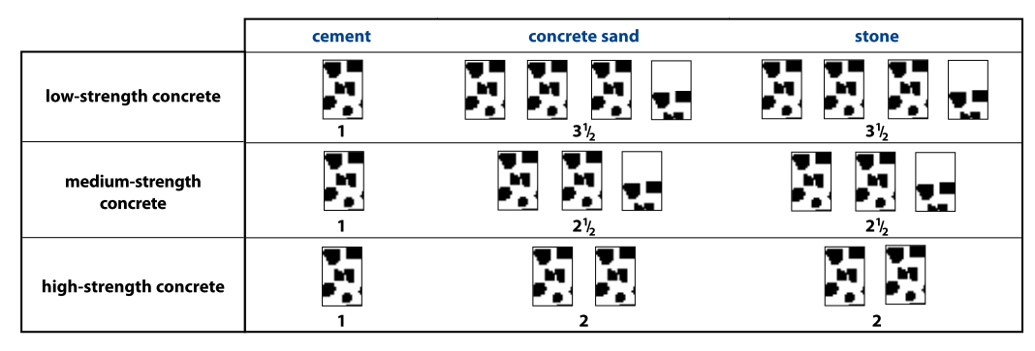
Volume Mix Proportions

Slide 10
Concrete Strengths
Low strength (15 MPa)
  Suitable for unreinforced foundations (single storey, mass fill, infill in masonry
Medium strength (25 MPa)
  Suitable for unreinforced slabs, reinforced slabs and foundations, footpaths and domestic driveways
High strength (30 MPa)
  Suitable for reinforced concrete members, heavy duty floors and precast items like flagstones.

Slide 11
Mix Proportions by Mass
Proportioning is given in mass or by weight
All constituent materials are weighed out accurately using scales
More accurate than volume batching
Mix can be adjusted for moisture content in aggregates
Mass batching recommended (>20MPa)

Slide 12
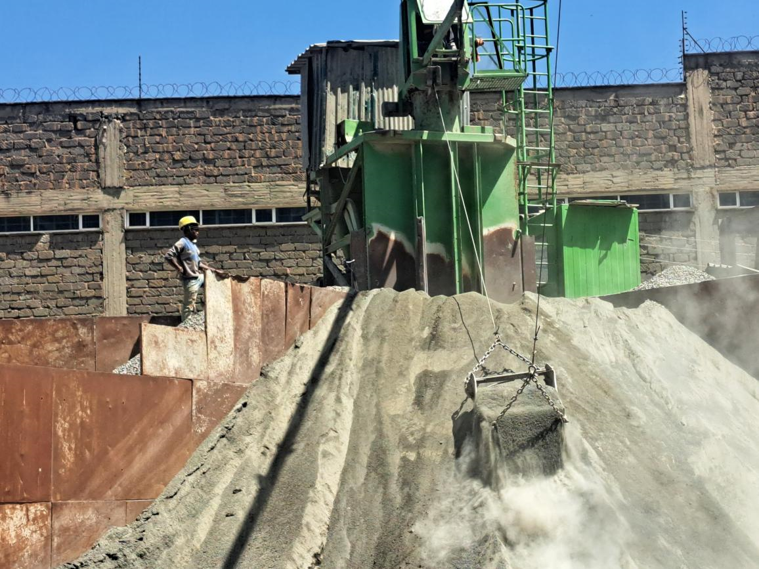
Mass Batching
Cement in separate hopper
Adjust for moisture in aggregate
Water mass or volume
Admixture very accurate
Check accuracy
Check measuring equipment
Keep hoppers clean inside and outside

Slide 13
Volume Batching
Use whole bags of cement
Aggregates damp and loose
Enough containers for whole batch
Containers rigid
Filled to top
Water by visual assessment
No admixtures

Slide 14
Material influence on mix design
Cement
  Quantity
    More cement makes mix cohesive
Fineness
  Type of cement
    Fly ash give better workability

Slide 15
Material influence on mix design
Fine aggregates (Sand)
  Major influence in water requirement
  Can influence up to 50 liters/m³
  Particle shape affects water requirement
  Fines content
    Too little makes harsh, bleeding, segregating mixes
    Too much makes high water requirement, high shrinkage, sticky mixes

Slide 16
Material influence on mix design
Stone (properties influencing mix proportions)
  Grading
  Size
    Larger than 19.0 mm makes harsher concrete
    Smaller that 19.0 mm makes expensive concrete
    Can blend different sizes to improve workability and durability
  Relative Density
  Shape
Better concrete with good grading, size and shape

Slide 17
Things to Remember
1 m³ of concrete weighs ±2400 kg
  2400 kg is a good approximation
  Use actual density if available
Yield of a mix
  2/3(volume of dry materials)
Volume of 50kg bag of cement is 33ℓ
1ℓ water = 1kg of water
1000ℓ = 1 m³
1 builders wheelbarrow holds 65ℓ

Slide 18
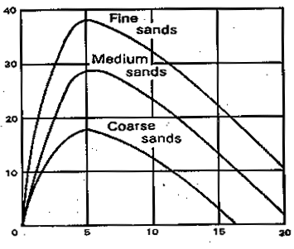
Bulking of Sand
Water causes surface tension bridges =>
Particles cannot slide =>
Particles cannot pack as well together =>
Increase in volume

Slide 19
Bulking of Sand
When volume batching, allowance to be made for bulking
Sand increases up to 20-30% as moisture content rises to 5%
Unless tests are done, assume 20% for bulking of sand

Slide 20
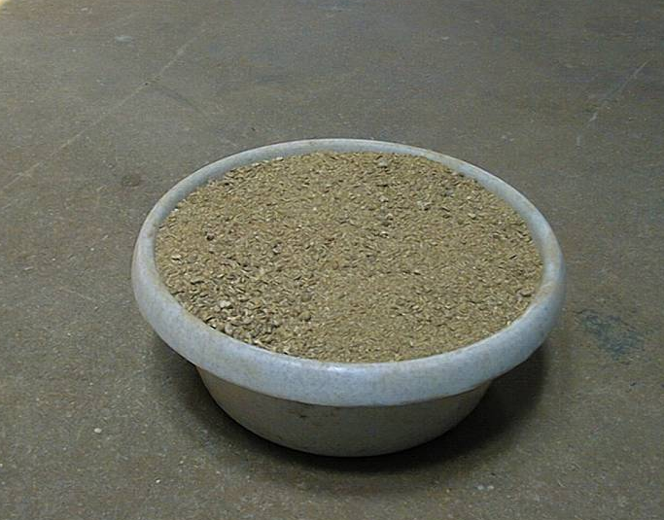
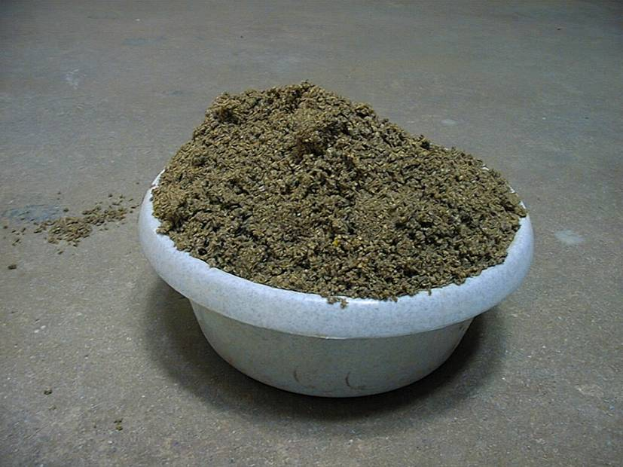
Bulking of sand
Dry un-bulked sand
Same sand - moist

Slide 21
Calculations for Bulking
To determine the bulking, a cylindrical container of volume A is filled with damp sand
Sand is then either dried and put back into the container or the empty container is filled with water and the damp sand put back in to displace the water. In either case, the depth of the sand is measured to give the un-bulked volume B.
A - B
Bulking =
X 100%
B

Slide 22
Calculations for Damp Sand
700 kg dry sand with 7% moisture
Batch 1,07 times 700 kg damp sand = 749 kg
Of this 700 kg is sand and 49 kg is water
So deduct 49 kg from the water

Slide 23
Example 1
  The following are mix proportions for 1 m³ of concrete from a laboratory
    Cement 375 kg
    Water 195 litres
    Stone 1103 kg
    Sand 727 kg
  The following information is also given
    Moisture content of sand 6 %
    Moisture content of stone 1.5 %
    Capacity of mixer 400 litres
  Calculate the batch proportions

Slide 24
Solution to Tutorial 1
Material | 1 m³ Mix | Moisture | Batch | 400 ℓ Mix
Cement | 375 kg | 375 kg | 375 kg | 150 kg
Water | 195 ℓ | 195 (-17-44) = | 134 ℓ | 54 ℓ
Stone | 1103 kg | 1103x0.015 = (17 kg) | 1120 kg | 448 kg
Sand | 727 kg | 727 x 0.06 = (44 kg) | 771 kg | 309 kg

Slide 25
Tutorial 2
  The following are mix proportions for 1 m³ of concrete from a laboratory
    Cement 325 kg
    Water 210 litres
    Stone 1030 kg
    Sand 835 kg
  The following information is also given
    Moisture content of sand 4.5%
    Moisture content of stone 2.0 %
    Capacity of mixer 300 litres
  Calculate the batch proportions

Slide 26
Solution to Tutorial 2
Material | 1 m³ Mix | Moisture | Batch | 300 ℓ Mix
Cement | 325 kg | 325 kg | 325 kg | 98 kg
Water | 210 ℓ | 210 (-21-38) = | 151 ℓ | 46 ℓ
Stone | 1030 kg | 1030x0.02 = (21 kg) | 1051 kg | 315 kg
Sand | 835 kg | 835 x 0.045 = (38 kg) | 873 kg | 262 kg

Slide 27
Tutorial 3
  The mix proportions of a concrete mix are given as follows. How much of each material will be required for a slab that is 15 m long, 5m wide and 150 mm deep?
    Cement 50 kg
    Water 30 ℓ
    Sand 123 kg
    Stone 140 kg

Slide 28
Solution to Tutorial 3
  Mass of mix = 50+30+123+140 = 343 kg
  Yield of mix = Mass ÷ 2400 x 1000 ℓ
= 343 ÷ 2400 x 1000 ℓ
= 143 ℓ
  Volume of concrete = 15 x 5 x 0.15 = 11.25 m³
  No of batches = 11.25 x 1000 ÷ 143 = 78.7 (79)
  Quantities of materials
    Cement 50 kg x 79 = 3950 kg (79 bags)
    Water 30 ℓ x 79 = 2370 ℓ
    Sand 123 kg x 79 = 9717 kg
    Stone 140 kg x 79 = 11060 kg

Slide 29
Mixing

Slide 30
Mixing
Precautions to be taken to maintain uniformity, consistency and homogeneity:
  Concrete to be thoroughly mixed
  Uniform throughout each batch, at required consistency
  Materials loaded in right order
    Stone, sand, cement and then the water
  Hopper is uniformly loaded
  Keep some water back and add later if needed
  Discharge mix in one operation
  Normal mixing time is two minutes after all materials, including water has been added
  Clean mixer thoroughly at the end of day

Slide 31
Types of Ready-Mix Trucks
Truck mixers
  Dry materials batched into them at depot, water added usually on site and mixed
Agitator trucks
  Loaded with pre-mixed concrete, which is agitated during transit.
  Not efficient mixers
Agitator/mixer truck
  Filled with pre-mixed concrete and this is efficiently re-mixed prior to placing.

Slide 32
Types of Mixer
Free-fall mixers:
  Tilting-drum
  Reversing-drum
  Split-drum mixer
Forced-action mixers
  Pan
  Paddle

Slide 33
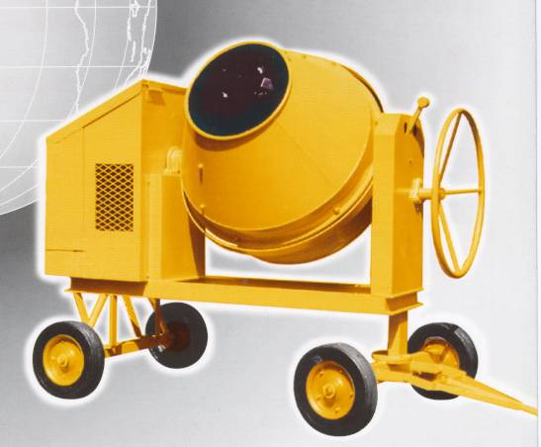
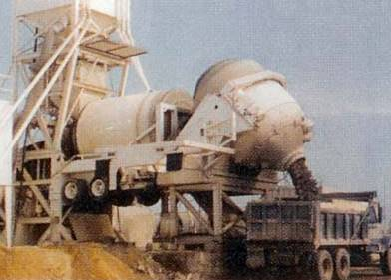
Tilting Drum
Either small (100-200 liters) or large (3 or 4 m³) for, respectively, medium strength and mass concrete with large aggregate
Drum is tilted to discharge
Blades lift materials to top of drum and allow them to fall
To avoid clogging, water in first

Slide 34
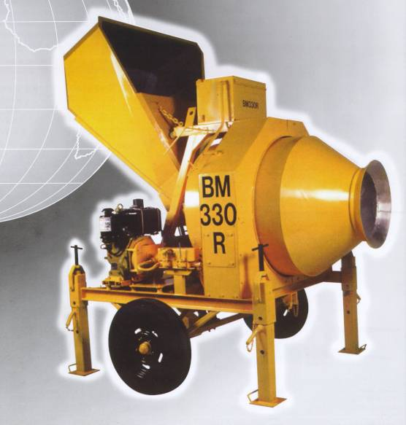

Reversing Drum Mixer
Two openings (back and front)
Two sets of blades
One set of blades mixes and other set discharges on opposite side to loading, when rotation is reversed
Good all-round mixers
Coping with most mixes except lean and sticky mixes
Output capacity range is
200 – 500 l

Slide 35
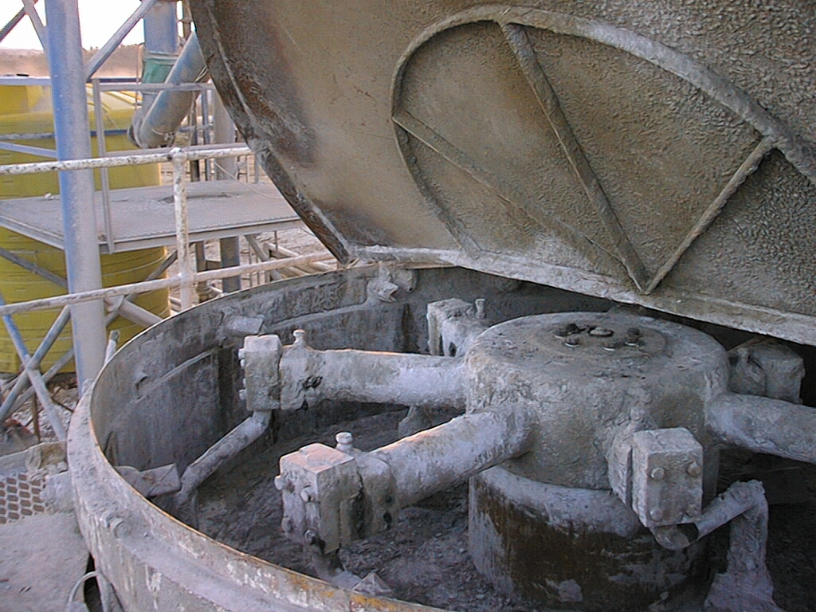
Pan Mixer
Use mechanical power to mix concrete
Pan is mounted horizontally
Mix much more thorough and faster
All types of concrete can be produced
Most versatile
Most expensive in energy consumption and wear
Output capacity range is 200 l to 3m³

Slide 36
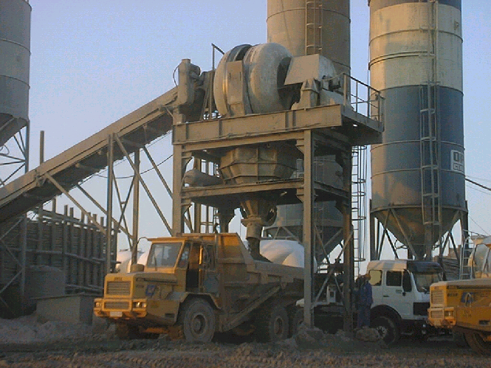
Split Drum Mixer
Although bulky, these mixers produce well-mixed
concrete quickly and in large quantities

Slide 37
Adjust for Mixer Size
Each mixer are designated by a number representing the batch capacity in liters and a letter indicating type of mixer
To adjust a mix for a specific size mixer, multiply each constituent amount with a factor that is proportioned on the batch capacity and capacity of available mixer
If bagged cement is used, quantities of other materials are proportioned to weight of cement in bag

Slide 38
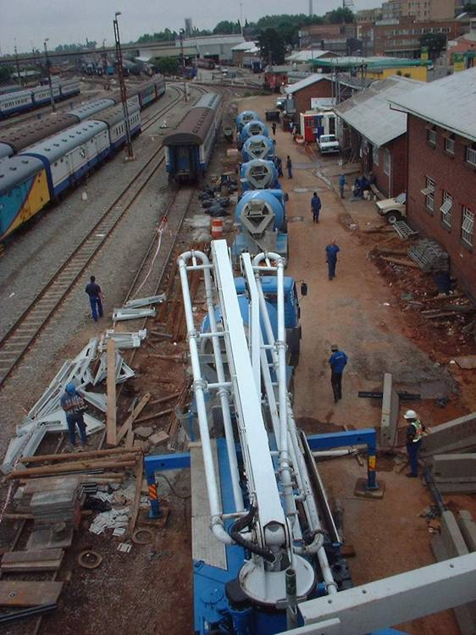
Transporting

Slide 39
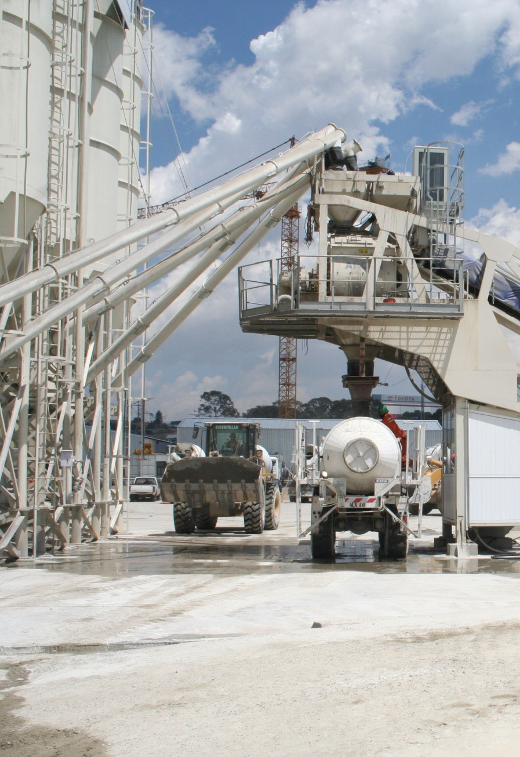
Objective of Transportation
  To move the concrete from the point of batching to the place of placing / casting as economically as possible, and with minimum alteration to the concrete’s properties

Slide 40
Possible Loss of Quality in Transportation
Workability
Contamination
Loss of fines
Segregation
Stiffening
Loss of water
No setting - Continued hydration of cement

Slide 41
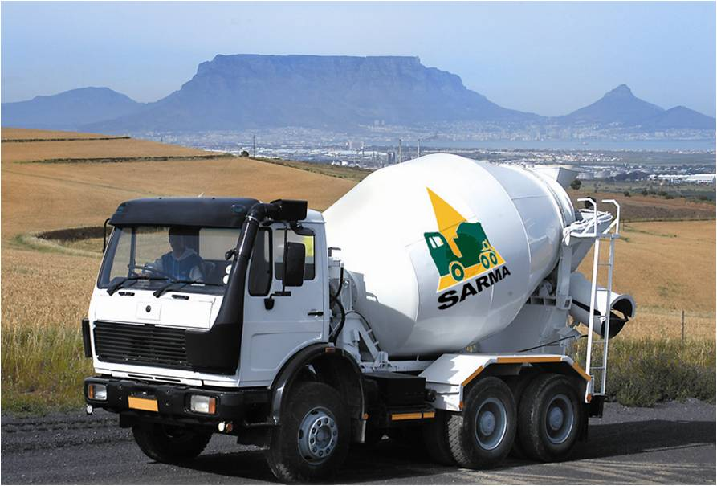
Methods
Wheeled transport-need clear, smooth routes
  Ready-mixed-concrete truck - 6 m³
  Wheelbarrow - 65 ℓ
  Dumpers - 500 to 750 ℓ
  Lorry or trailer - 3 to 8 m³
Selection
  Rate of mixing and placing
  Haul distance and quality of road

Slide 42
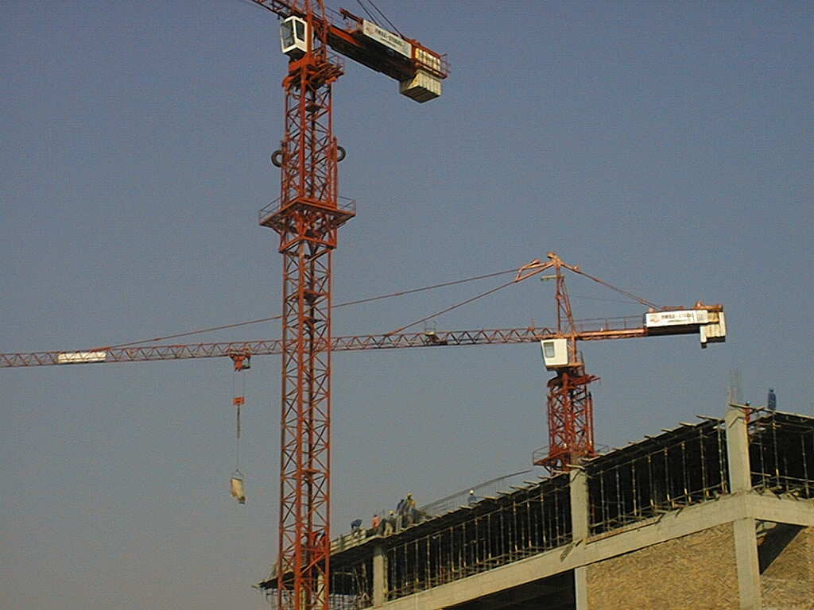
Other Methods
Skips
  Rollover or Constant altitude
  Moved by tower cranes
Builders Hoist
Conveyor
Pumping

Slide 43
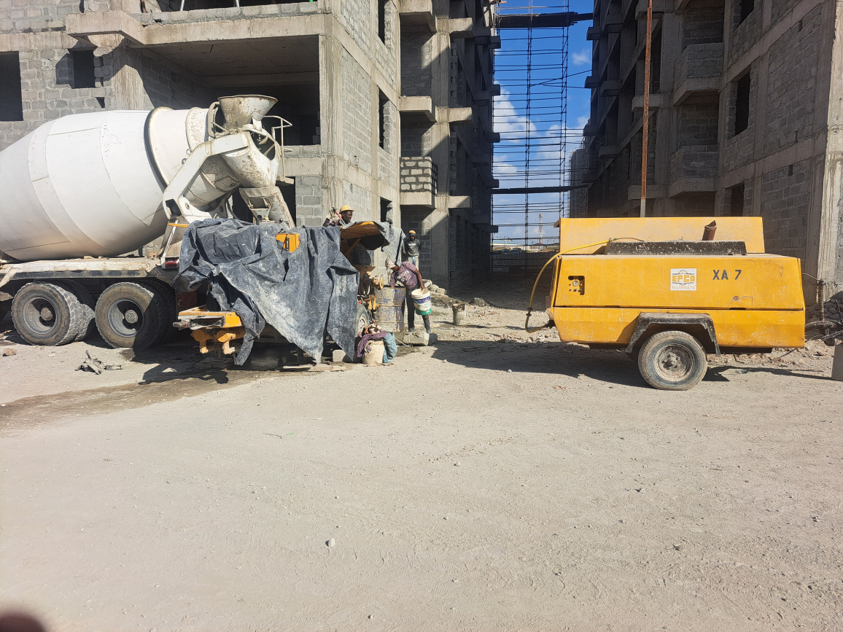
Precautions when transporting
Close tailgates of lorries and skips
Short, flat, smooth routes
Cover concrete to prevent contamination
Minimum delays
Use equipment that suit the type of concrete
Avoid unnecessary jolting of concrete
Guide concrete into forms with a chute, elephant trunk or a tremie
Lower the temperature of aggregates and water in hot weather

Slide 44
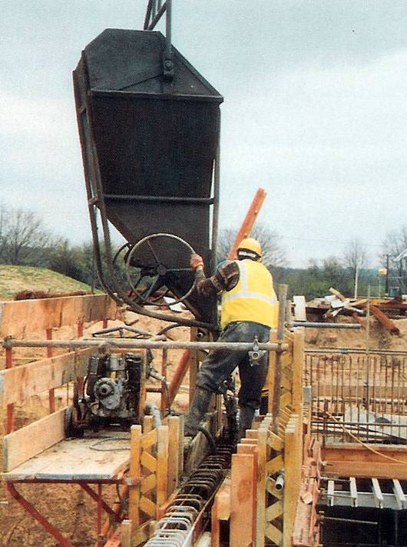
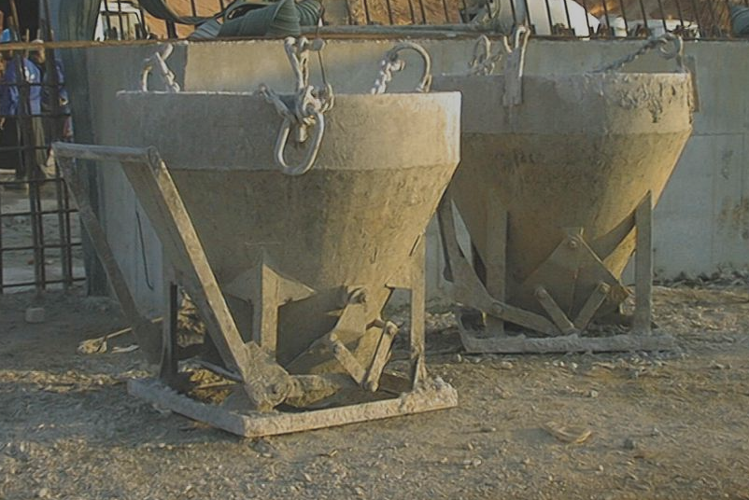
Different Skips
Constant level/altitude
Lay-back or roll-over

Slide 45
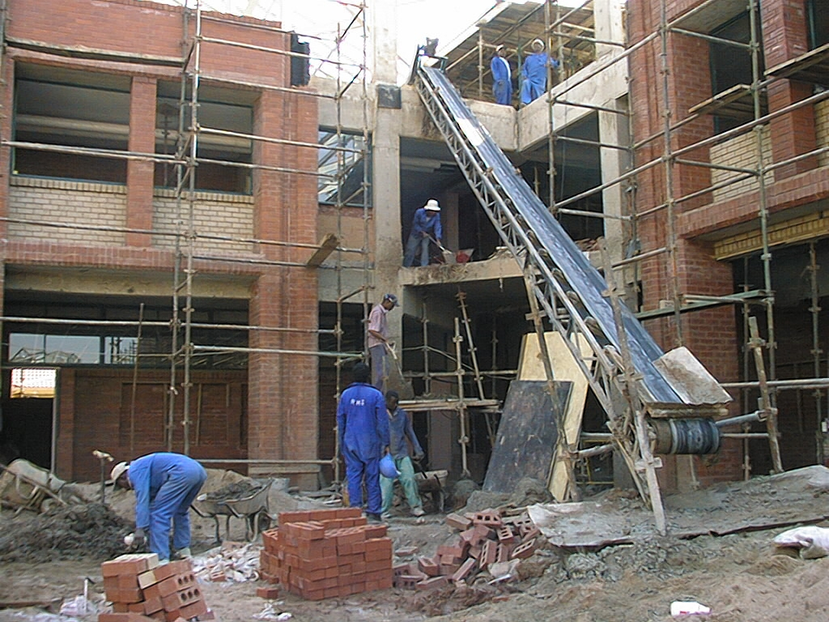
Conveyor

Slide 46
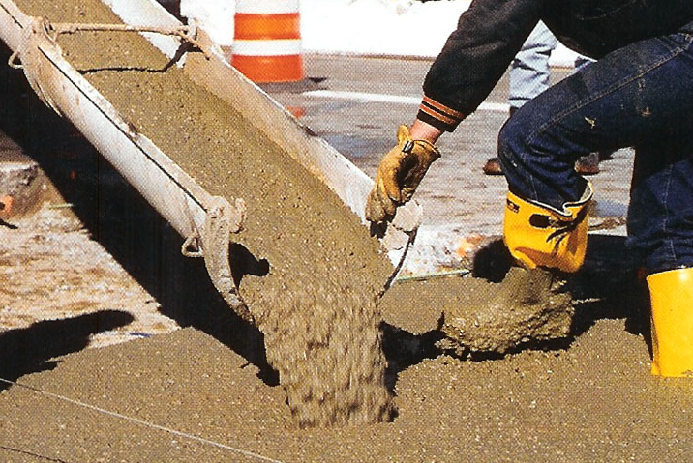
Placing

Slide 47
Placing of Concrete
Placement
  Never move concrete with a vibrator
  Place in uniform layers
  Layer thickness to match compaction
  Place while layer underneath is still plastic
  Start from bottom on slopes
  Place into corners
  Generally place in its final position within thirty minutes of leaving the mixer
  Use elephant trunking or a tremie
Reject unsuitable concrete

Slide 48
Good Placing Practices
Should be placed and compacted before setting starts
Placing should prevent concrete segregation
Do not let concrete free-fall more than 1m to prevent segregation
Should be placed after checking the formwork and necessary preparation of surface
Should be placed continuously to avoid irregular and unsightly lines
Placing should not disturb position of formwork and reinforcement
Placing should not be done when it is raining
Walking on freshly placed concrete should be avoided
Concrete should be placed as near as possible to its final position
Use chutes and tremie pipes as guides.

Slide 49
Managing Delays
Use retarding admixture
Reduce rate of placement
Cool down concrete
Use mist spray to humidify area

Slide 50
Pumped concrete: Managing Delays
Fill pump hopper with last batch of concrete and pump small quantities at intervals of about 10 minutes to prevent concrete stiffening in the lines
Place the end of the flexible hose into the pump hopper and slowly recirculate the concrete through the pump
Pumping Aids -These are specially formulated admixtures that act as lubricants, reducing friction between the concrete and the pump lines. To improve the pumpability of wet concrete, materials like pumping aids (long-chain polymers or surfactants), water-reducing admixtures, and superplasticizers are added to the mix, lubricating the concrete and facilitating its passage through pipes
  Long-chain polymers: These provide cohesion to the mix, preventing bleeding and water loss, and help maintain a layer of cement paste around the coarse aggregate particles.
  Surfactants: These increase the paste volume and reduce aggregate interlock, creating a smoother, more pumpable slurry.

Slide 51
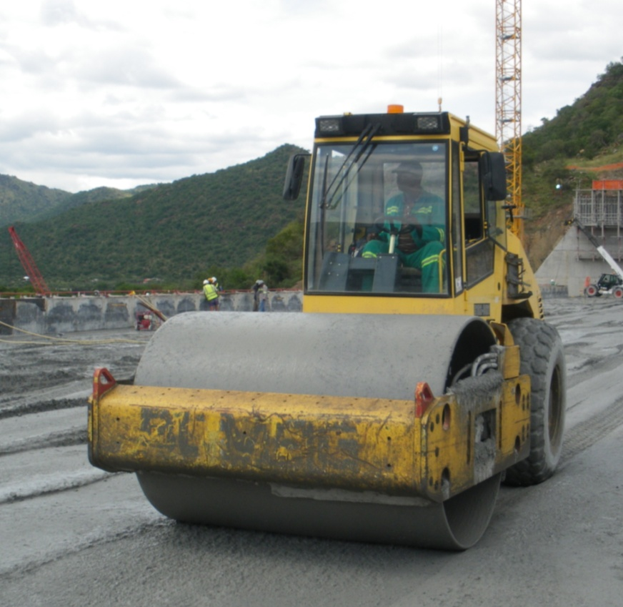
Compaction

Slide 52
Compaction
To remove entrapped air (voids) from the concrete to consolidate it
  Air reduces concrete strength - 1% air will reduce concrete strength by up to 6%
  Increases impermeability
  Improve bond to steel
  Voids are aesthetically displeasing
Protect steel reinforcement
Better off shutter finish
Densification of concrete making it durable

Slide 53
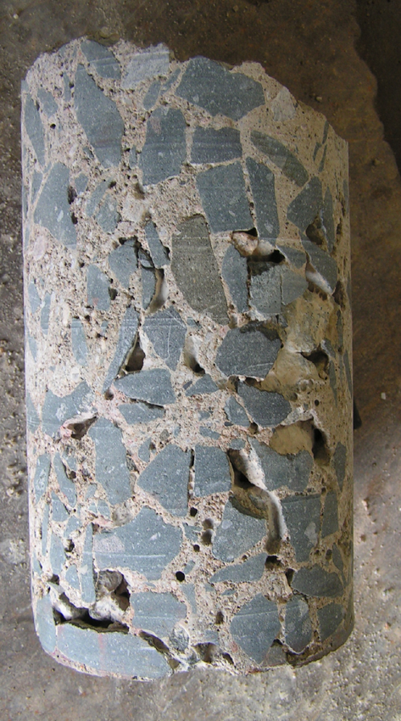

Honeycomb
In concrete construction, "honeycombing" refers to voids or cavities that appear in the hardened concrete, often resembling a honeycomb pattern, due to incomplete filling of the formwork or improper compaction during the pouring process

Slide 54
Compaction
Methods
  Self-compaction
  Hand-compaction
  Vibration
Compaction is complete when:
  Bubbles stop rising
  Surface becomes level and shines
  Sound changes when poker is used
Care must be taken to ensure that concrete is well compacted against the formwork and at corners and junctions

Slide 55
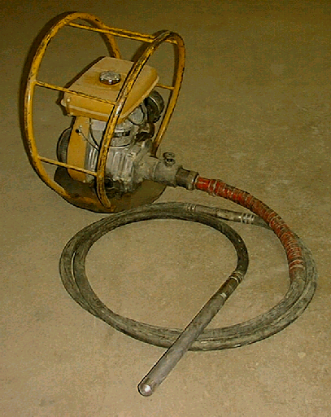
Compacting Equipment
Internal - Poker vibrator
  Most commonly used
  Most effective, transmit vibration directly into concrete
  Used in walls, beams, columns and edges of slabs
  Insert vertically and quickly
  Withdraw slowly (to prevent leaving a hole)
  Insert at intervals less than 10 poker diameters

Slide 56
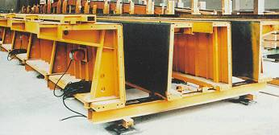
Compacting Equipment
External - Form vibrator
  Less efficient than pokers
  Formwork must be very strong
  Best suited to pre-casting operations
  Air bubbles tend to migrate to source of vibration and get trapped on the form face

Slide 57
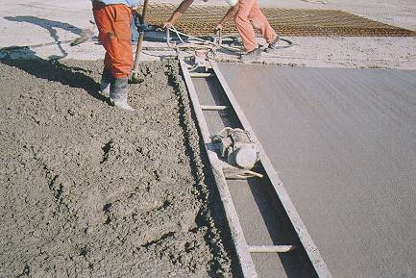
Compacting Equipment
Surface vibrators – Beam vibrators
  Vibrating unit mounted at centre
  Used to compact floor slabs and roads
  Effective to a depth of 150 mm, edges not well compacted

Slide 58
Compacting Equipment
Vibratory rollers
  Used for very low slump concrete
  High compactive effort
  Roller compacted concrete
  Used in dam and road construction
  Aggregate grading and moisture content critical, if too wet concrete will stick to roller, too dry leads to under compaction.

Slide 59
Self-Compacting Concrete
In its fresh state, SCC flows freely into every corner of the formwork without the need for compaction
Fills formwork and encapsulates reinforcing steel bars only through action of gravity
Maintains homogeneity (no segregation)
Behaves like a liquid in the fresh state

Slide 60
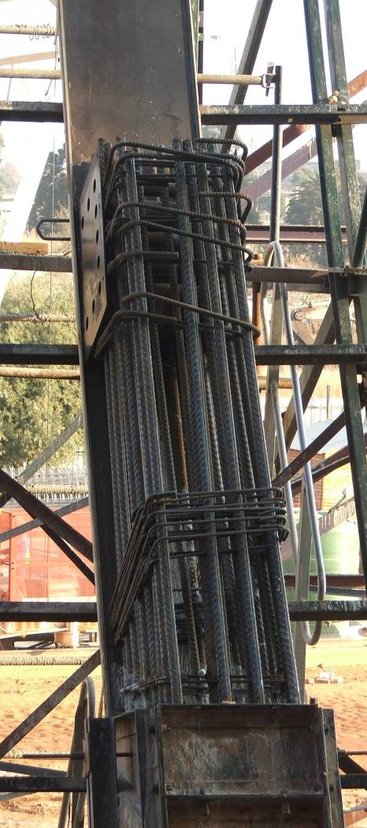
Reasons for SCC Use
Improved quality assurance of cast structures
New design options
  Ensure compaction when structural design makes compaction difficult or impossible
  Create opportunity for innovative construction systems
Congested reinforcing

Slide 61
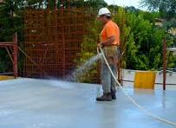
Curing

Slide 62
Curing
Curing is the operation by which moist conditions are maintained on the placed concrete surfaces to promote continued hydration of cement for concrete to acquire full strength
It is the process of preventing loss of moisture from concrete while maintaining a satisfactory temperature regime. The curing regime should prevent development of high temperature gradients within concrete
It prevents shrinkage cracks developing in the concrete.
Curing brings about improvements in durability, impermeability, wear and weather resisting qualities and reduces shrinkage.

Slide 63
Factors affecting curing
The lower the curing temperature, the slower the rate at which concrete will harden (but concrete cured at a low temperature will have improved strength; however, this is not normally critical and is often economically unviable). If the temperature of the plastic concrete falls below freezing point, the water in it will freeze, expand and cause permanent damage. Delays or intermittent curing can reduce or eliminate effect of curing
There are several methods of curing. Adoption of specific method depends upon the nature of work and the climatic conditions.

Slide 64
Effects of Curing
Keeps the concrete warm enough for the hydration reaction to proceed
Ensures that hydration carries on to the fullest possible extent to improve concrete strength
Increases resistance to abrasion
Ensure a hard, dense surface.

Slide 65
Effects of Curing
Reduces permeability, which ensures durability and increases strength, which, in turn, resists stresses caused by:
    Differential shrinkage
    Frost expansion
    Temporary loads
    Design loads
    Differential expansion.

Slide 66
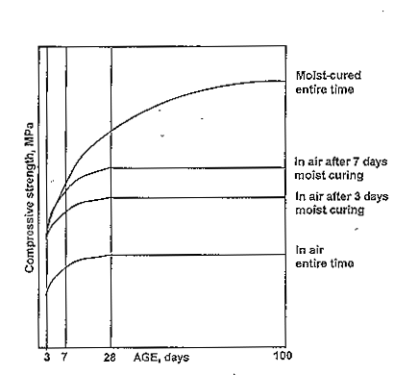
Effect of Moisture

Slide 67
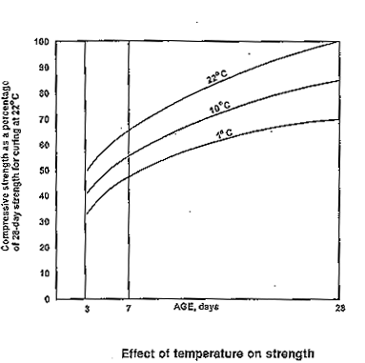
Effect of Temperature

Slide 68
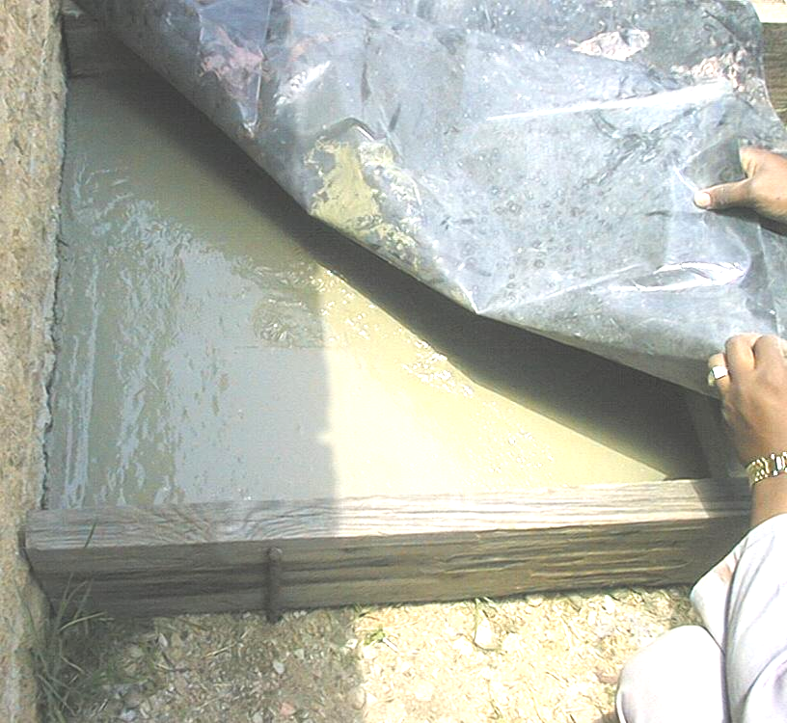
Curing Methods
Polythene sheeting
  Placed directly onto wet concrete will produce marks on surface
  Ends to be firmly held down to prevent formation of wind tunnel
Formwork
  Cure vertical surface and exposed tops will need covering. Forms are eased away to stop sticking to concrete which can lead to discolouration at top.

Slide 69
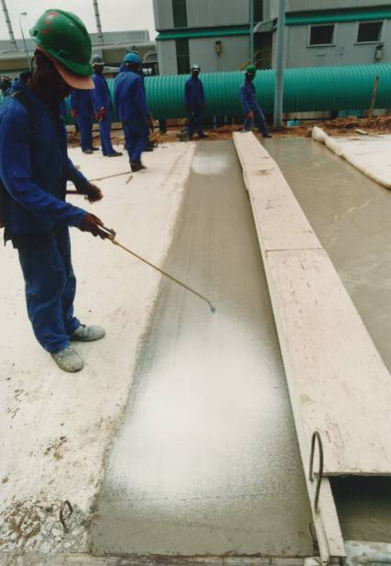
Curing Methods
Curing membranes
  Cannot be applied to very wet or dry concrete
  Contain fugitive dye to show extent of coverage
  Not suitable if renderings or other coatings are to follow
Wet covering
  Can stain the concrete surface
  Must be kept wet constantly
  Do not use when there is frost.

Slide 70
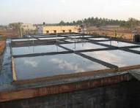
Other Curing Methods
Shading of concrete work
Covering the surfaces of concrete with wet gunny bags
Sprinkling water
Ponding

Slide 71
A Caution on Curing
In all cases, the surface to be cured should not be allowed to dry
This should be continued for a minimum period of 7 days. However, the curing reaction takes place over a very long period of time - Concrete is commonly designed on the basis of strength that it reaches after 28 days.
If concrete is allowed to dry out at any point during the 28 days after placing, the strength of the resulting concrete will be reduced, and its surface hardness and durability are likely to be adversely affected.

Slide 72
Curing in Frosty weather
In winter, curing must also act as frost protection. The 19 mm thick plywood sheets used for a lot of formwork is a good insulator. Slabs and other exposed elements need protecting with insulating blankets or expanded polystyrene. Hot air blowers can easily cause plastic shrinkage cracks if there is insufficient water in the surrounding environment.

Slide 73
Curing Large Concrete Masses
Large pours of more than 1.5 m thick need insulation to keep the outer surfaces at much the same temperature as the core, otherwise the resultant temperature differential can cause either external or internal cracking.

Slide 74
‘Secrets’ of Good Concrete Production and Application
Batching by weight
Ensuring a good quality proportion and type of cement
Strict control of water-cement ratio
Correct type, proportions, storage, grading and quality of aggregates
Correct method and adequacy of batching, mixing, transporting, placing, compacting and curing of the concrete.

Slide 75

Feedback
feedback

